Slide 1
Thesis and Dissertation Proposals
University Learning Centre
Writing Help
Ron Cooley, Professor of English
ron.cooley@usask.ca

Slide 2
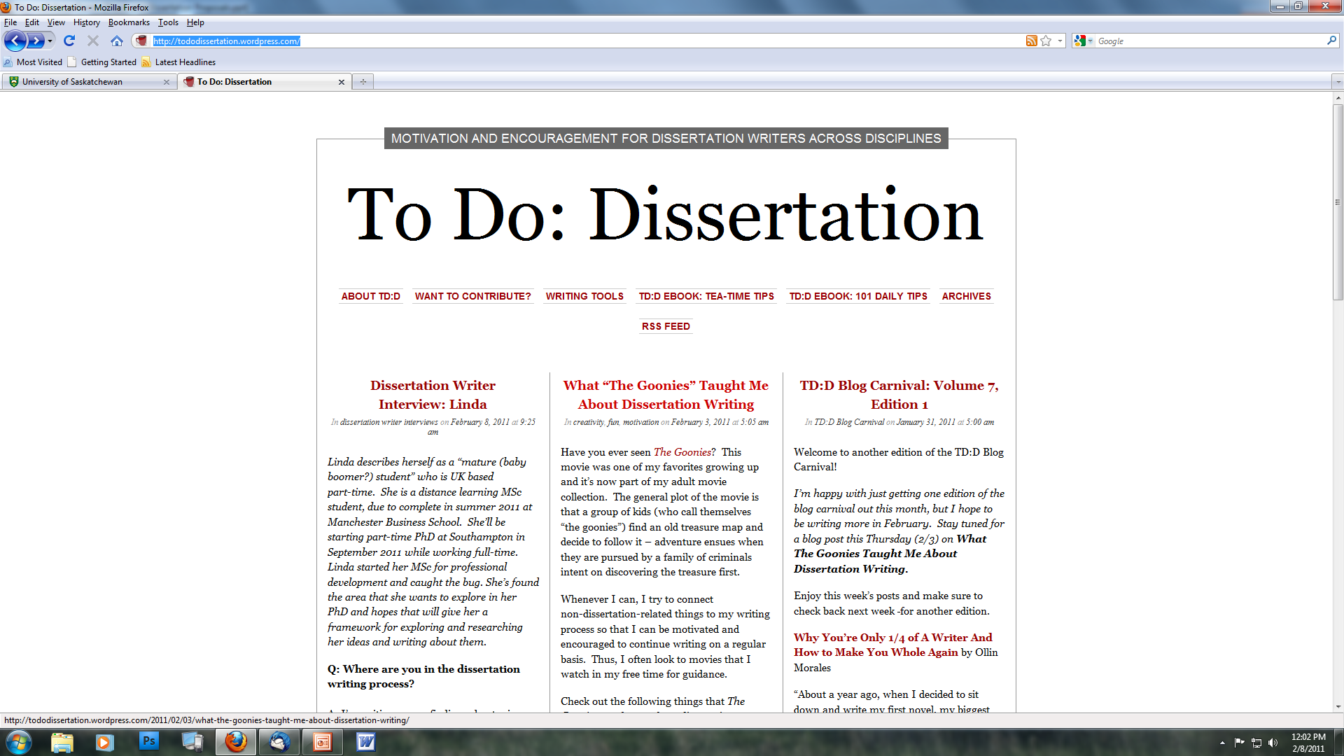
http://tododissertation.wordpress.com/

Slide 3
Disciplinary differences
Different departments and disciplines have different expectations of thesis and dissertation proposals.
Things to ask your supervisor or graduate chair (or look up in your department’s Graduate Handbook)
  How long should the proposal be?
  When is it due (or expected)?
  Who approves it?
  Is there a form or template?
  Are there samples from other students I can look at?
  How much direction should I expect from my supervisor?

Slide 4
Thesis and Dissertation Proposals
Audience of a thesis proposal
What purposes does the proposal serve?
What are the components of a typical thesis/dissertation proposal
Some considerations regarding specific components
The Writing Process
A few Stylistic Considerations and conventions

Slide 5
Who is the audience for a thesis proposal?
Who has the authority to accept/reject?
How would you characterize that audience?
Research Supervisor/Adviser
  degrees of involvement in conceptualizing the research.
Student’s Advisory Committee
  expert, detail-oriented, well-informed.
  May be part of research team?
Departmental Graduate Committee?
  broader range of interests, expertise
  smaller stake in the specific results of the research
  need more “bridging” information

Slide 6
What distinguishes this audience from, say, the audience of a Grant or Fellowship proposal?
A close connection to the student
A direct interest in the student’s success
A duty to protect the reputation of department, research group, institution
A sense of history, tradition, customary practice (students new to a department have to learn this—often from fellow students)

Slide 7
Thesis and Dissertation Proposals
Audience of a thesis proposal
What purposes does the proposal serve?
What are the components of a typical thesis/dissertation proposal
Some considerations regarding specific components
The Writing Process
A few Stylistic Considerations and conventions

Slide 8
What purposes does the proposal serve for the candidate?
A Persuasive Tool to convince your department or committee that:
  There is a need for the research; it is significant and important.
  You are contributing something original to the field.
  The topic is feasible in terms of available funding, equipment, supervisors, and data.
  The research can be completed in the expected time period (appropriate limitations and boundaries)
  Ethical issues have been considered and appropriate approval given.
  The topic matches your interests and capabilities.
An Outline for Thesis to advance the writing of the thesis itself.
  Chapter Structure/Table of Contents may carry over from proposal to thesis.
  Some components of the thesis may even be substantially complete in the proposal (literature review; methods) (e.g. Psychology)
A Writing Exercise

Slide 9
What purposes does the proposal serve for the department or committee?
A Contract
  to ensure that candidate, supervisor and department agree on the nature of the research. (e.g. Computer Science)
An Educational Tool
  practice in academic writing,
  practice in research design,
  build candidate’s knowledge about state of research in the field

Slide 10
Thesis and Dissertation Proposals
Audience of a thesis proposal
What purposes does the proposal serve?
What are the components of a typical thesis/dissertation proposal
Some considerations regarding specific components
The Writing Process
A few Stylistic Considerations and conventions

Slide 11
Components of a thesis proposal
I would like to propose solving X. The traditional way to solve X is stupid, while my way is most excellent. The traditional way suffers from all sorts of problems. My way suffers from none of these problems. I have built a prototype that takes "input" and converts that input into what I call "output." The output of my prototype is excellent, although I could make it even more excellent. This is what I would like to propose to do.
What’s here that a proposal requires?
What’s missing that a proposal requires?

Slide 12
Components of a thesis proposal
I would like to propose solving X. The traditional way to solve X is stupid, while my way is most excellent. The traditional way suffers from all sorts of problems. My way suffers from none of these problems. I have built a prototype that takes "input" and converts that input into what I call "output." The output of my prototype is excellent, although I could make it even more excellent. This is what I would like to propose to do.
Concise statement / research question

Slide 13
Components of a thesis proposal
I would like to propose solving X. The traditional way to solve X is stupid, while my way is most excellent. The traditional way suffers from all sorts of problems. My way suffers from none of these problems. I have built a prototype that takes "input" and converts that input into what I call "output." The output of my prototype is excellent, although I could make it even more excellent. This is what I would like to propose to do.
Literature review

Slide 14
Components of a thesis proposal
I would like to propose solving X. The traditional way to solve X is stupid, while my way is most excellent. The traditional way suffers from all sorts of problems. My way suffers from none of these problems. I have built a prototype that takes "input" and converts that input into what I call "output." The output of my prototype is excellent, although I could make it even more excellent. This is what I would like to propose to do.
Methodology
Preliminary work done

Slide 15
Components of a thesis proposal
I would like to propose solving X. The traditional way to solve X is stupid, while my way is most excellent. The traditional way suffers from all sorts of problems. My way suffers from none of these problems. I have built a prototype that takes "input" and converts that input into what I call "output." The output of my prototype is excellent, although I could make it even more excellent. This is what I would like to propose to do.
Key terms defined and applied

Slide 16
Components of a thesis proposal
While thesis proposals vary from discipline to discipline, the following are generally required:
Abstract or concise statement
Introduction
Literature Review (sometimes part of intro; sometimes separate)
Research question(s) or hypothesis
Definitions of key terms and concepts
Description of procedures/methods (preliminary work completed)
Tentative chapter outline (some disciplines)
Suggested timeline (most disciplines)
Identification of resources required (most disciplines)
Bibliography or Reference List

Slide 17
Thesis and Dissertation Proposals
Audience of a thesis proposal
What purposes does the proposal serve?
What are the components of a typical thesis/dissertation proposal
Some considerations regarding specific components
The Writing Process
A few Stylistic Considerations and conventions

Slide 18
Some considerations regarding specific components
Research question(s) or hypothesis
Topic vs. Issue vs. Question
Topic: Self-management educational for children and adolescents with asthma
Issue: The effectiveness of self-management educational interventions for children and adolescents with asthma
Research Question: Do self-management educational interventions improve lung function and decrease morbidity and health care use in children and adolescents with asthma? (Cochrane Database Systematic Review, 2003)

Slide 19
Literature Review
What’s the function of a literature review?
  Educational—demonstrate your readiness to begin research—knowledge of the field
  Intellectual—gap analysis—allow you to identify a suitable research question or problem
How comprehensive does it have to be?
  PhD vs. Masters?
  Disciplinary customs and conventions?
  How late or how early in the research is the proposal required?
What are you doing besides reading and summarizing?
  Classifying (according to methods, results)
  Identifying patterns of influence (who cites whom and how do others interpret or build on peers’ results)

Slide 20
Description of procedures/methods
  What will be done, how, and why?
  Explain (and if necessary justify) your choices.
  Explain connections between methods and hypotheses.
  In general, proceed from broad to specific. Provide necessary context before specific details. (e.g. don’t describe specific experimental treatments before explaining the overall approach and the different independent and dependent variables.)

Slide 21
Thesis and Dissertation Proposals
Audience of a thesis proposal
What purposes does the proposal serve?
What are the components of a typical thesis/dissertation proposal
Some considerations regarding specific components
The Writing Process
A few Stylistic Considerations and conventions

Slide 22
The Writing Process
Consider Writing from the “inside-out.”
  The sequence of composition need not be the sequence of presentation.
  Write (at least in draft form) sections you feel able to write as soon as you are able.
  Arrange and revise sections later.

Slide 23
Thesis and Dissertation Proposals
Audience of a thesis proposal
What purposes does the proposal serve?
What are the components of a typical thesis/dissertation proposal
Some considerations regarding specific components
The Writing Process
A few Stylistic Considerations and conventions

Slide 24
Stylistic considerations and conventions
Verb tenses
Use Present tense to relate what other authors say and to discuss the literature, theoretical concepts, methods, etc.
  “In her article on biodiversity, Jones stipulates that ….”
Also, use the present tense to present your observations on the literature.
  “However, on the important question of extinction, Jones remains silent.”
Use Past tense to recount events, procedures, results, etc.
  “Jones and Green conducted experiments over a ten-year period. They determined that it was not possible to recreate the specimen.”
Use Future tense to anticipate actions and describe plans.
  Proposals normally rely more heavily on future tense than dissertations do, since the research is not yet completed (or perhaps, not even begun)
  “This thesis will challenge Jones and Green’s conclusions about biodiversity and will propose a new approach to the problem of species extinction.”

Slide 25
Stylistic considerations and conventions
First person
Since this is YOUR proposal, some use of the first person (“I” ) is probably inevitable.
BUT, pay close attention to disciplinary conventions.
Some disciplines (many Science and Social Sciences disciplines) insist that the first person is NEVER used in formal academic writing.
Thesis proposals in the College of Education (for example) sometimes use first person rather liberally.
When in doubt, THINK—what purpose would the first person serve?
  Statements like “I feel” or “I believe” usually weaken an assertion rather than strengthening it.
  BUT to differentiate your research from that of others in the context of a proposal “I propose” is usually clearer and more accurate than “this study proposes”

Slide 26
Stylistic considerations and conventions Active/passive voice
When a sentence is written in the passive voice, the object of the action becomes the subject of the sentence.
Scientists and social scientists use the passive voice a lot. They write
“Steps a, b, and c will be performed” (passive voice), rather than
“I will perform steps a, b, and c.” (active voice)

Slide 27
Stylistic considerations and conventions Active/passive voice
BUT passive voice is wordy, and often leaves out important information.
Remember--not every sentence has to be written this way.
Hint—try to use the active voice when the subject of the sentence is not “I”
  “57 subjects completed the questionnaire” (active)
  is clearer and more economical than
  “The questionnaire was completed by 57 subjects” (passive)
and
  “Smith and Jones’s analysis yielded two significant insights”
  is clearer and more economical than
  “Two significant insights have been derived from Smith and Jones's anaylsis”

Slide 28
Vocabulary
The technical terms in our disciplines are complicated enough.
Never “pad” your writing.
Use simple, common terms (but not colloquialisms or slang) when they convey your meaning accurately.
  “Use” is just as good as “utilize”; “aware that . . . ” is better than “cognizant of the fact that . . .”
As in all academic writing, your main stylistic goals are accuracy and economy IN THAT ORDER!

